Slide 1
White Oak Park Town Hall Meeting
February 26, 2013

Slide 2
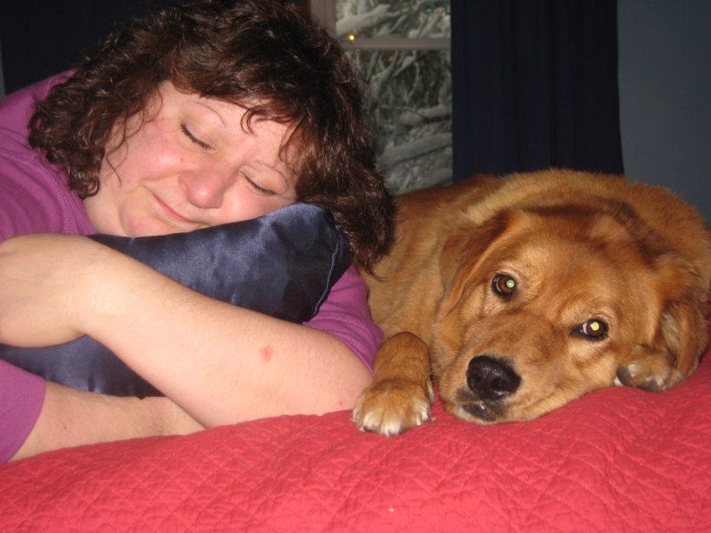
How did this idea get here?
Started as my 8th grade project at VMS
Borough bought Heritage Hills Property
Idea put on hold because money was not available and plan was not yet created for the property
Approached by Recreation
Chairman to add dog park to plan
My inspiration, my mom, passed away
Naming dog park in her honor

Slide 3
Why does Oakland need a dog park?
2012: Oakland gave out 1,288 dog licenses
Oakland’s human population is 12,754
Oakland’s hilly terrain is a negative for dog owners
Dog Park provides a closed and flat area for dogs to get exercise
Town parks do not allow dogs and/or limit dogs to being on a leash
Parks nearby do not allow dogs to roam free
Ramapo Reservation requires dogs to be leashed
Ramapo State Forest: good for hiking, not running and playing
Nearest dog parks are several miles away
Pequannock, Ridgewood, Hawthorne, Ringwood, West Milford

Slide 4
Benefits of a Dog Park in Oakland
Dog park appeals to almost all dog owners, especially those without a fenced in yard, due to rocky ground
Shows that Oakland is a pet friendly town
A plus for current homeowners and families who are considering moving to Oakland
Good for local businesses
Educational opportunity for people to look at different dogs and consider getting a dog
Could be a positive for RBARI

Slide 5
Benefits of a Dog Park
The American Kennel Club states that dog parks:
“allow dogs to exercise and socialize safely”
“promotes responsible dog ownership” by “preventing off-leash animals from infringing on the rights of other community residents and park users such as joggers, small children, and those who may be fearful of dogs”
“provide an outlet for dog owners to socialize”
“makes for a better community by promoting public health and safety as well-exercised dogs are less likely to create a nuisance, bark excessively, and destroy property”

Slide 6
Dog Park Perspectives
Mr. Vince Rambala from Vince Rambala Dog Training
“A dog park can be very beneficial to exercise our dogs and allow them to properly socialize with other friendly dogs of same size. Owners need to watch the interactions to make sure that the dogs are not playing too rough or one dog is not bullying the other dogs and a dog fight breaks out.”
Mrs. Babette Haggerty from Haggerty’s School for Dogs
“Dog parks are great socialization arenas for dogs. It helps to develop them socially and improve their behavior. Not only is it a benefit to dogs but to their owners as well as it gives owners a place to socialize and meet others with similar interests in a very relaxed environment.”
Dr. Gary Duhr from Ramapo Valley Animal Hospital
“Dog parks are a safe environment for you and your dog to have fun together and bond. They enable dogs to keep an active and healthy lifestyle while also helping to improve their socialization skills. A dog park would be a great addition to Oakland!”

Slide 7
Design Concept

Slide 8
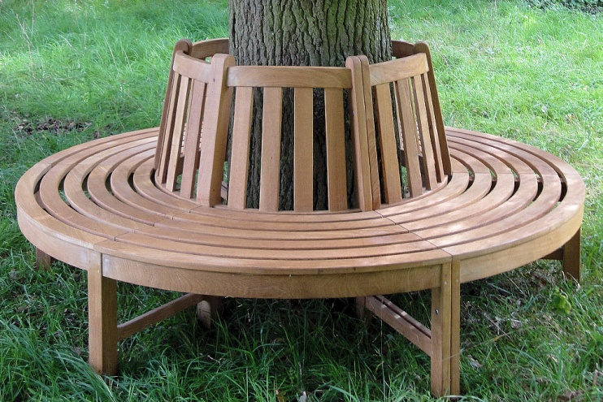
Dog Park Design Features
Two separate areas, large and small dogs
Separated by a small wooded area
Double gate entrance
Safety precaution
Keep large trees for shade
Keeps park cool in summertime
Trees will be encircled by tree benches
A natural wooded barrier is left between dog parks and Rt. 202
Paving stone walkway would connect both parks together, would also have benches

Slide 9
Cost Analysis
Average fencing estimate for work proposed: $18,000
Cedar Mulch for both parks: $15,200
Park Signage: about $4,000
Information/Sponsor sign: $4,000-$6,000
Dog Disposal Stands: $600-$800
Garbage/Recycling bins: $700-$1,000
Blank Paving Stones*: about $11,000
*Assuming all paving stones used are blank. Cost would decrease depending on number of engraved paving stones ordered
TOTAL COST: $50,000 - $56,000

Slide 10
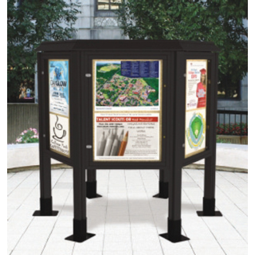
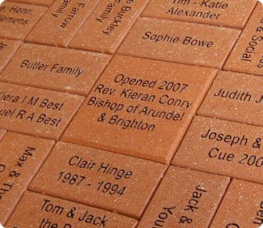
Ways to Fundraise
Businesses and individuals who donate over a certain amount will get be recognized on an information board
Engraved paving stones
Oakland, N.J. Seal Lapel Pins
Dog park logo turned into magnet

Slide 11
Ideas to Reduce Costs and Raise Revenue
Information sign, rules sign, and tree benches can be built by Boy Scouts or willing volunteers
Base mulch from wood chipped trees during park construction
Enforce current Borough code regarding dog waste
Allow advertisements to be hung up along dog park fencing
Add $2 fee to Oakland Dog Registration to fund maintenance costs
Would raise about $2,500 yearly
Non-resident dog park usage fee with similar process to dog tag registration
$2-5 yearly fee to use the park

Slide 12
Dog Park for Oakland, New Jersey
Get the latest updates on facebook!
Dog Park for Oakland, NJ
Email: dogrun4oakland@yahoo.com

